Slide 1
Skewness
Skewness is a statistical measure that describes the asymmetry of a distribution around its mean. It provides insights into the shape of the data distribution, particularly how data points are distributed in relation to the mean.
When the curve does not get the symmetry
When the data is given, you draw a curve on the basis of that data.
When the curve is not symmetric, it is called skewness.

Slide 2
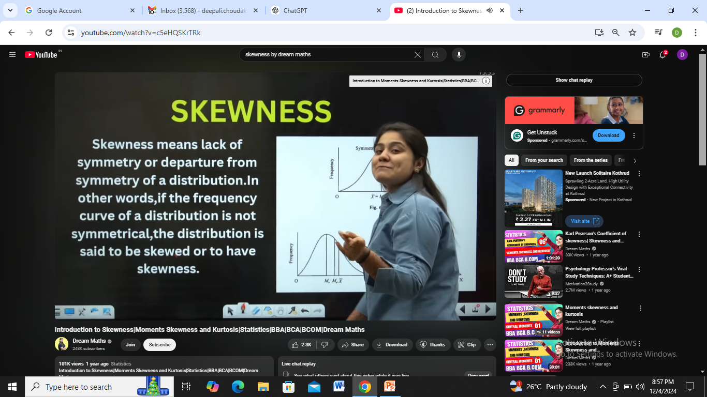
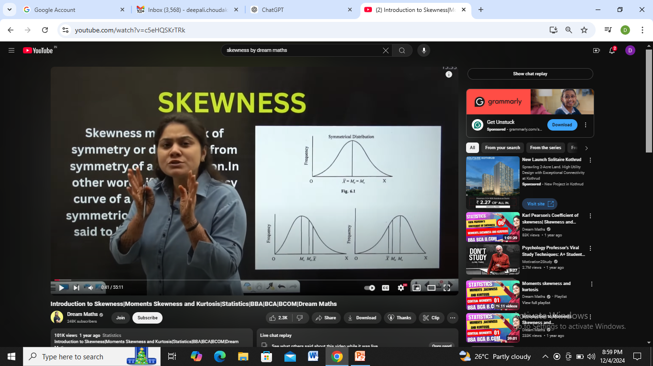

Slide 3
Types of Skewness
Positive Skewness (Right-Skewed):
The tail on the right side of the distribution is longer or fatter than the left. If the frequency curve of a distribution has a longer ‘Tail’ to the right of the central maximum than to the left, the distribution is said to be skewed to the right or to have a psitive skewness.
Most of the data values are concentrated on the left of the mean.
The mean is greater than the median.
Mean>Median>Mode
Example: Income distribution, where a few individuals have very high incomes.

Slide 4
Negative Skewness (Left-Skewed)
The tail on the left side of the distribution is longer or fatter than the right.
If the frequency curve of a distribution has a longer ‘Tail’ to the left of the central maximum than to the right, the distribution is said to be skewed to the left or to have a negative skewness.
Most of the data values are concentrated on the right of the mean.
The mean is less than the median.
Mean<Median<Mode
Example: Age at retirement, where most people retire around the same age, but a few retire earlier.
Zero Skewness (Symmetrical):
The distribution is perfectly symmetrical.
The mean, median, and mode are equal.
Example: A perfectly normal distribution.

Slide 5
Interpreting Skewness Values
Skewness > 0: Positive skew.
Skewness < 0: Negative skew.
Skewness ≈ 0: Symmetrical distribution.
Applications of Skewness
Helps in identifying trends in data.
Guides decision-making in finance, economics, and research by highlighting data asymmetry.
Useful in risk management and forecasting.

Slide 6
Test of Skewness
If the values of Mean, Median & Mode do not coincide (if they are not equal, then it is skewness)
The frequency curve of the distribution is not a symmetric bell shaped curve but stretched more towards one side than other

Slide 7
Kurtosis
Kurtosis measures the "tailedness" or sharpness of a data distribution.
It indicates the peakness of the curve
The normal curve is called as Mesokurtic
The highest sharp peak is called as Platonurtic
The more flattened curve is called as Leptokurtic

Slide 8
Measure of Dispersion
Measure of Dispersion refers to how spread out or varied the data is. It shows how much individual data points differ from the central value (mean, median, or mode).

Slide 9
Key Measures of Dispersion
Range:
The difference between the highest and lowest values in a dataset.
Formula:
Range=Highest value−Lowest value
Example: In the set {2, 4, 7, 10}, the range is 10−2=810 - 2 = 810−2=8.

Slide 10
Variance:
Measures the average squared deviation from the mean.
A larger variance means the data is more spread out.
Standard Deviation:
The square root of variance. It shows the average distance of each data point from the mean.
Formula:
Standard deviation =square root Variance​
Example: If the standard deviation is 3, most data points are within 3 units from the mean.

Slide 11
Why It’s Important
Helps understand how consistent or spread out data is.
Larger dispersion means more variability, while smaller dispersion means the data points are closer to the mean.
In simple terms, dispersion tells us whether the data is tightly packed or widely spread out.

